Slide 1
Inventory Management System Group 6

Slide 2
Team
Employee ID | Name | Worked on
2498866 | Sakshi Shukla | Backend
2496209 | Soudha Anusha | Backend
2496149 | Meduri Bhanu Priya | Backend
2495997 | Kajal Sanjayrao Shahane | Backend
2495794 | Manda Tejaswini | Frontend/Backend
2496371 | Singadi Dileep | Frontend
2499082 | Guduguntla Keerthi | Frontend
2494095 | Shaikhkureshi Samrin Vikramuddin | Frontend
2498719 | Bindhu MS | Frontend

Slide 3
Content
Introduction
Objective
Web Application Block Diagram
Technologies
Modules
ER Diagram
Workflow
Testing (Postman / JUnit)
Output
Advantages and disadvantages
Scope

Slide 4
Introduction
An inventory management system project that allows user to manage and maintain his/her inventory with ease.
It is important to ensure quality control in businesses that handle transactions revolving around consumer goods.
The inventory management system has been developed to allow users to add an inventory, delete an inventory, enter inventory quantity and other details, update inventory status and more.

Slide 5
Objective
The objectives of inventory management are to provide the desired level of customer service, to allow cost-efficient operations, and to minimize the inventory investment.
To ensure a continuous supply of materials and stock so that production should not suffer at the time of customers demand.
To eliminate duplication in Items stocks.
To maintain a systematic record of inventory.
To ensure the quality of goods at reasonable prices.

Slide 6
Technologies
We can developed project on any operating system using MySQL , hibernate , spring boot.
Frontend: Angular Js
Server-side: Spring Boot, JPA, Hibernate
Backend: MYSQL
Web Server: Apache Tomcat

Slide 7
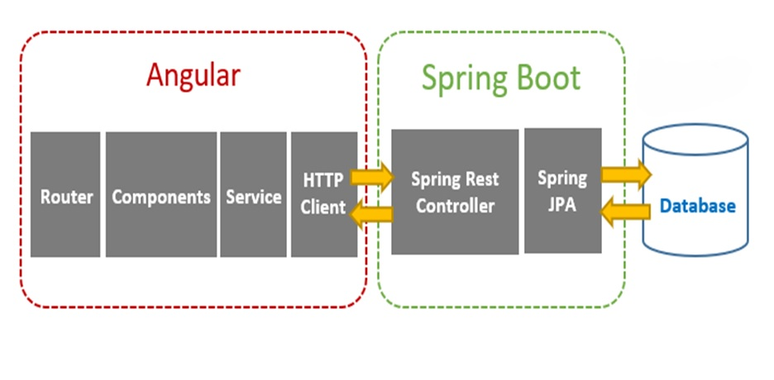
Web Application Block Diagram

Slide 8
Modules
Registration
Login
Customer
Item
Purchase
Sales

Slide 9
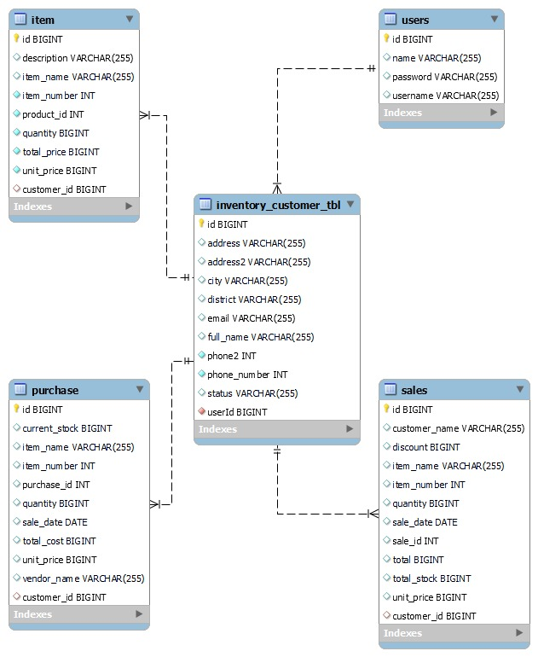
ER DIAGRAM

Slide 10
Workflow
User has to visit the URL and need to click on Register button if he/she don’t have login account.
One he register by providing he required details on the webpage like Name, Username and Password. he can login to system using username and password which he/she added at the time of registration.
Login User need to create a customer in the system by filling the form.
Login User will create an item in item module by adding all required fields.
Login User will create a purchase details then based on the purchase details he will create a sales record in sales module.

Slide 11
Postman Testing
Postman is an API client that makes it easy for developers to create, share, test and document APIs.
This is done by allowing users to create and save simple and complex HTTP/s requests, as well as read their responses.
After the completion of backend, we use postman tool which help us to check the functionality of the system.
In the postman we explore the operations to add, delete, read, and update the record data in database with the help of http requests and responses.

Slide 12
JUnit Testing
JUnit is a Regression Testing Framework used by developers to implement unit testing in Java, and accelerate programming speed and increase the quality of code.
JUnit promotes the idea of "first testing then coding", which emphasizes on setting up the test data for a piece of code that can be tested first and then implemented.
If we execute the test cases by tool support, it is known as automated testing.
Provides assertions for testing expected results.
Provides test runners for running tests.

Slide 13
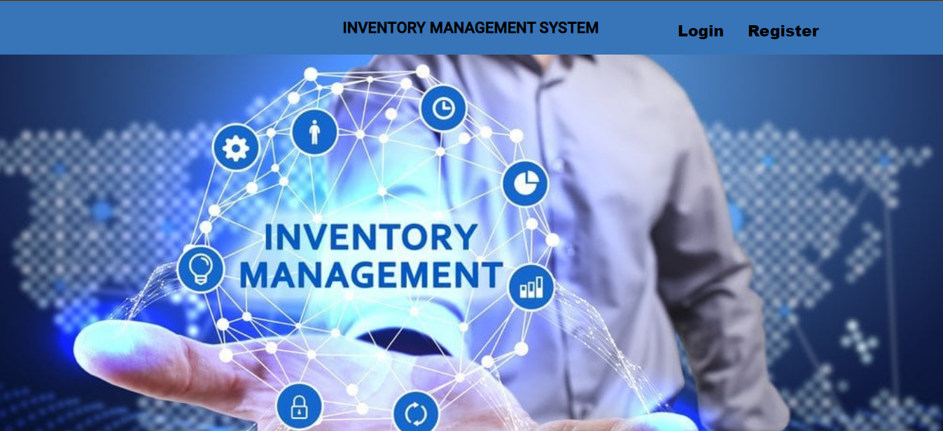
Outputs : Home Page

Slide 14
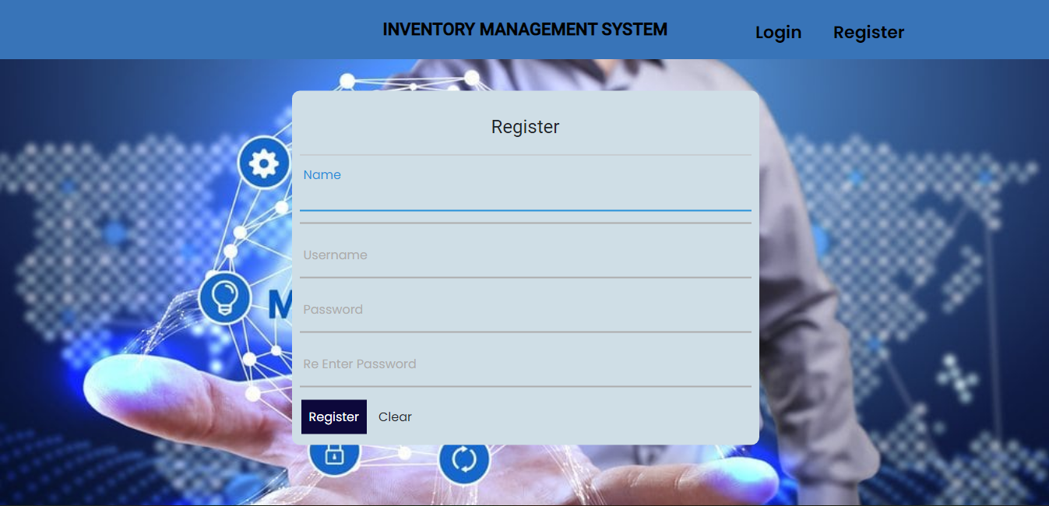
Register Page

Slide 15
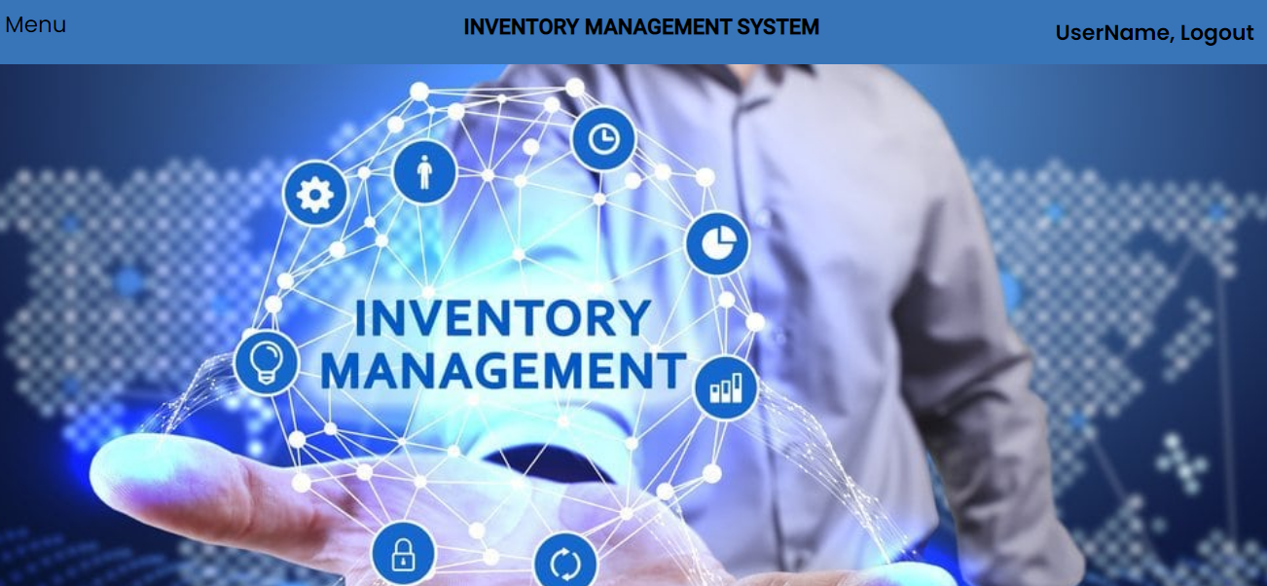
Login Home Page

Slide 16
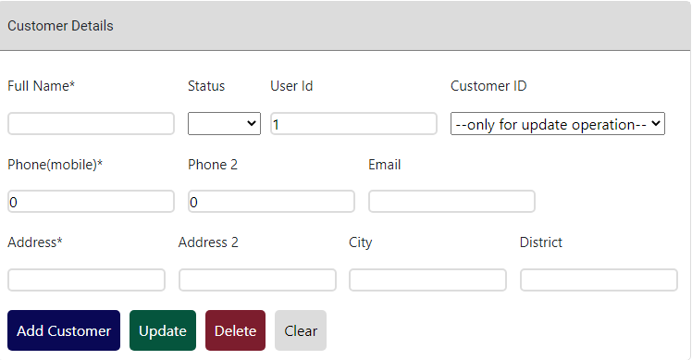
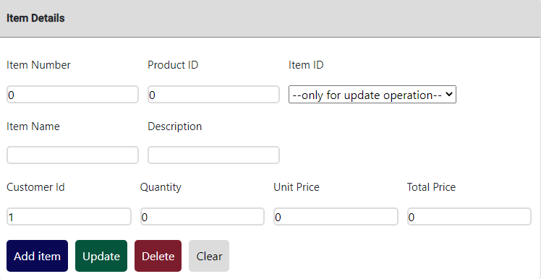
Customer / Item Details Module

Slide 17
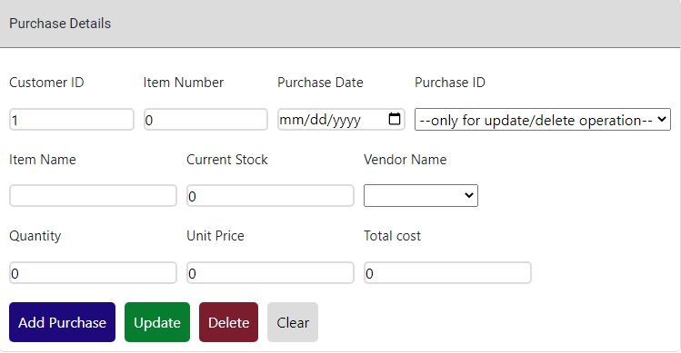
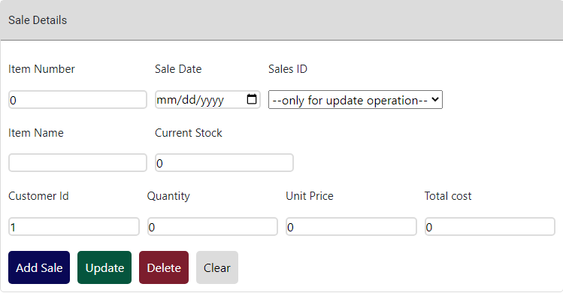
Purchase / Sales Details Module

Slide 18
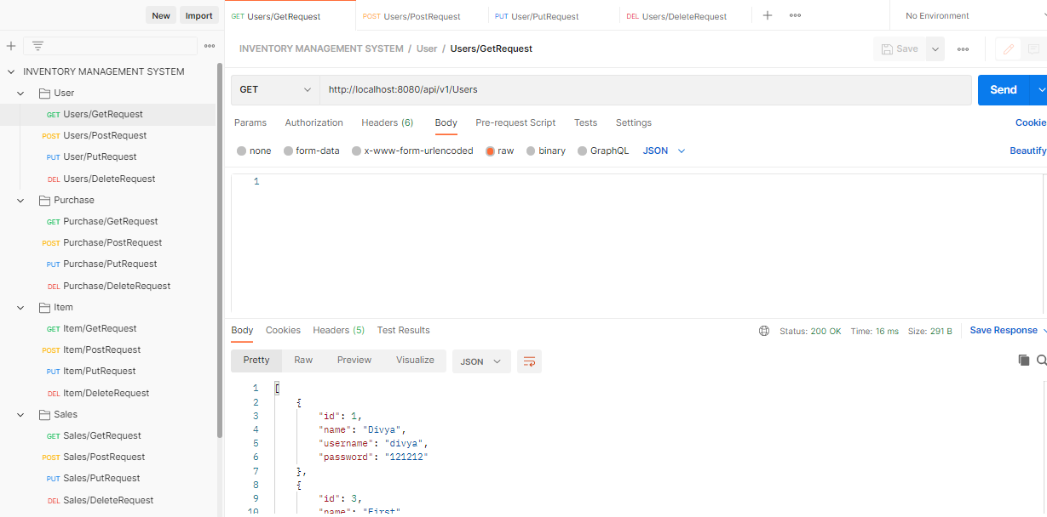
Postman output

Slide 19
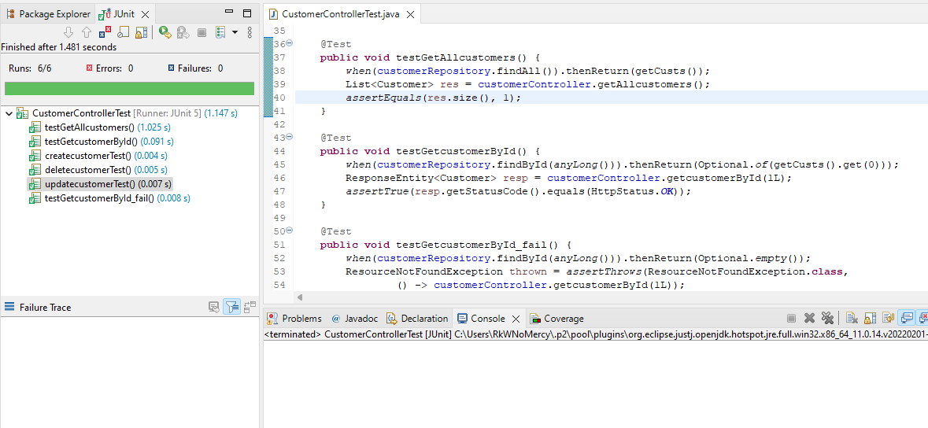
Junit Output

Slide 20
ADVANTAGES
It Reduces Risk of Overselling.
Avoiding Stockouts and Excess Stock.
A More Organized Warehouse.
Determining Major Order Picking Systems.
Better Customer Experience.

Slide 21
disadvantages
Production problem.
Increased space is need to hold the inventory.
Complexity.
High implementation costs.

Slide 22
scope
We can take feedbacks from the Customers to improve the Customer relationship.
Reporting for each module we can implement.
Customer login can be implemented.
Import data from excel sheet for all modules.

Slide 23


